Slide 2
Objectives
Explain triggers
Explain the different types of triggers
Explain the procedure to create DML triggers
Explain the procedure to alter DML triggers
Describe nested triggers
Describe update functions
Explain the handling of multiple rows in a session
Explain the performance implication of triggers

Slide 3
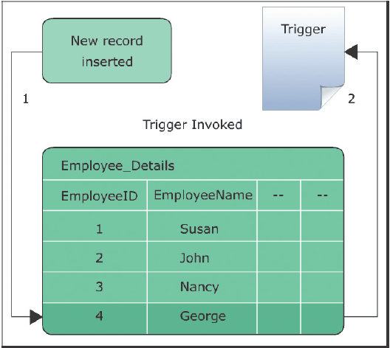
Introduction
A trigger:
is a stored procedure that is executed when an attempt is made to modify data in a table protected by the trigger.
cannot be executed directly, nor do they pass or receive parameters.
is defined on specific tables and these tables are referred to as trigger tables.
is defined on the INSERT, UPDATE, or DELETE action on a table, it fires automatically when these actions are attempted.
is created using the CREATE TRIGGER statement.

Slide 4
Uses of Triggers
Triggers can contain complex processing logic and are generally used for maintaining low-level data integrity. Primary uses of triggers can be classified as follows:
Cascading changes through related tables
Enforcing complex data integrity than CHECK constraints
Defining custom error messages
Users can use a trigger to cascade changes through related tables.
Unlike CHECK constraints, triggers can reference the columns in other tables.
Are used for providing more suitable or detailed explanations in certain error situations.
Can be used to apply complex data integrity checks by,
Creating multi-row triggers for actions executed on multiple rows
Checking constraints before cascading updates or deletes
Enforcing referential integrity between databases

Slide 5
Transact-SQL Programming Elements
Transact-SQL programming elements enable to perform various operations that cannot be done in a single statement.
Maintaining denormalized data
Comparing before and after states of data being modified
Low-level data integrity can be maintained in denormalized database environments using triggers.
Triggers provide the option to reference changes that are made to data by INSERT, UPDATE, and DELETE statements.
Denormalized data generally refers to redundant or derived data. Here, triggers are used for checks that do not require exact matches.
.

Slide 6
Types of Triggers
A trigger can be set to automatically execute an action when a language event occurs in a table or a view. Triggers in SQL Server 2012 can be classified into three basic types:
DML Triggers
DDL Triggers
Logon Triggers
Execute when data is inserted, modified, or deleted in a table or a view using the INSERT, UPDATE, or DELETE statements.
Execute when a table or a view is created, modified, or deleted using the CREATE, ALTER, or DROP statements.
Execute stored procedures when a session is established with a LOGON event.
.

Slide 7
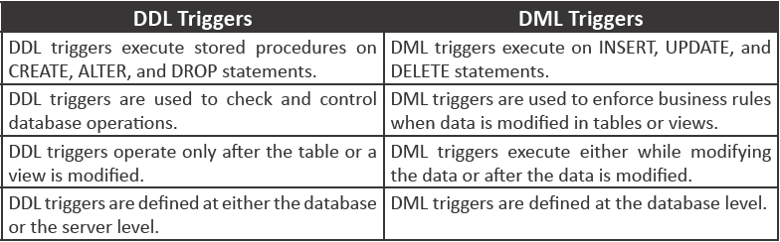
DDL Triggers versus DML Triggers
DDL and DML triggers have different uses and are executed with different database events.
Following table lists some of the Transact-SQL control-of-flow language keywords:

Slide 8
Creating DML Triggers
DML triggers are executed when DML events occur in tables or views. These DML events include the INSERT, UPDATE, and DELETE statements.
DML triggers can execute either on completion of the DML events or in place of the DML events.
DML triggers enforce referential integrity by cascading changes to related tables when a row is modified.
DML triggers can perform multiple actions for each modification statement.
DML triggers are of three main types namely, INSERT trigger, UPDATE trigger, and DELETE trigger.

Slide 9
Introduction to Inserted and Deleted Tables
SQL statements in DML triggers use two special types of tables to modify data in the database. These tables are as follows:
Inserted Table
Deleted Table
Contains copies of records that are modified with the INSERT and UPDATE operations on the trigger table.
Contains copies of records that are modified with the DELETE and UPDATE operations on the trigger table.
The INSERT and UPDATE operations insert new records into the Inserted and Trigger tables.
These operations delete the records from the trigger table and insert them in the Deleted table.
The Inserted and Deleted tables do not physically remain present in the database and are created and dropped whenever any triggering events occur.

Slide 10
Insert Triggers 1-4
Are executed when a new record is inserted in a table.
Ensure that the value being entered conforms to the constraints defined on that table.
Save a copy of that record in the Inserted table and checks whether the new value in the Inserted table conforms to the specified constraints.
Insert the row in the trigger table if the record is valid otherwise, it displays an error message.
Are created using the INSERT keyword in the CREATE TRIGGER and ALTER TRIGGER statements.

Slide 11
Insert Triggers 2-4
Syntax:
CREATE TRIGGER [schema_name.] trigger_name
ON [schema_name.] table_name [WITH ENCRYPTION]
{FOR INSERT} AS
[IF UPDATE (column_name)...]
[{AND | OR} UPDATE (column_name)...]
<sql_statements>
where,
schema_name: specifies the name of the schema to which the table/trigger belongs.
trigger_name: specifies the name of the trigger.
table_name: specifies the table on which the DML trigger is created.
WITH ENCRYPTION: encrypts the text of the CREATE TRIGGER statement.
FOR: specifies that the DML trigger executes after the modification operations are complete.
INSERT: specifies that this DML trigger will be invoked by insert operations.
UPDATE: Returns a Boolean value that indicates whether an INSERT or UPDATE attempt was made on a specified column.

Slide 12
Insert Triggers 3-4
column_name: Is the name of the column to test for the UPDATE action.
AND: Combines two Boolean expressions and returns TRUE when both expressions are TRUE.
OR: Combines two Boolean expressions and returns TRUE if at least one expression is TRUE.
sql_statement: specifies the SQL statements that are executed in the DML trigger.
Following code snippet shows how to create an INSERT trigger on a table named Account_Transactions:
CREATE TRIGGER CheckWithdrawal_Amount
ON Account_Transactions
FOR INSERT
AS
IF (SELECT Withdrawal From inserted) > 80000
BEGIN
PRINT 'Withdrawal amount cannot exceed 80000'
ROLLBACK TRANSACTION
END

Slide 13
Insert Triggers 4-4
Following code snippet inserts a record and displays an error message when the Withdrawal amount exceeds 80000:
INSERT INTO Account_Transactions
(TransactionID, EmployeeID, CustomerID,TransactionTypeID,TransactionDate,
TransactionNumber,Deposit,Withdrawal)
VALUES
(1008,'E08','C08','T08','05/02/12','TN08', 300000,90000)
Output:
Withdrawal amount cannot exceed 80000.

Slide 14
Update Triggers 1-5
Copies the original record in the Deleted table and the new record into the Inserted table when a record is updated.
Evaluates the new record to determine if the values conform to the constraints specified in the trigger table.
Copies the record from the Inserted table to the trigger table provided the record is valid.
Displays an error message if the new values are invalid and copies the record from the Deleted table back into the trigger table.
Is created using the UPDATE keyword in the CREATE TRIGGER and ALTER TRIGGER statements.

Slide 15
Update Triggers 2-5
Syntax:
CREATE TRIGGER [schema_name.] trigger_name
ON [schema_name.] table_name [WITH ENCRYPTION]
{FOR UPDATE} AS
[IF UPDATE (column_name)...]
[{AND | OR} UPDATE (column_name)...]
<sql_statements>
where,
schema_name: specifies the name of the schema to which the table/trigger belongs.
trigger_name: specifies the name of the trigger.
table_name: specifies the table on which the DML trigger is created.
WITH ENCRYPTION: encrypts the text of the CREATE TRIGGER statement.
FOR: specifies that the DML trigger executes after the modification operations are complete.
INSERT: specifies that this DML trigger will be invoked after the update operations.
UPDATE: Returns a Boolean value that indicates whether an INSERT or UPDATE attempt was made on a specified column.

Slide 16
Update Triggers 3-5
column_name: Is the name of the column to test for the UPDATE action.
AND: Combines two Boolean expressions and returns TRUE when both expressions are TRUE.
OR: Combines two Boolean expressions and returns TRUE if at least one expression is TRUE.
sql_statement: specifies the SQL statements that are executed in the DML trigger.
Following code snippet shows how to create an UPDATE trigger at the table level on the EmployeeDetails table:
CREATE TRIGGER CheckBirthDate
ON EmployeeDetails
FOR UPDATE
AS
IF (SELECT BirthDate From inserted) > getDate()
BEGIN
PRINT 'Date of birth cannot be greater than today's date'
ROLLBACK
END

Slide 17
Update Triggers 4-5
Following code snippet updates a record and displays an error message when an invalid date of birth is specified:
UPDATE EmployeeDetails
SET BirthDate='2015/06/02'
WHERE EmployeeID='E06')
Output:
Date of birth cannot be greater than today's date.
Creating Update Triggers
Are created either at the column level or at the table level.
Triggers at the column level execute when updates are made in the specified column.
Triggers at the table level execute when updates are made anywhere in the entire table.
UPDATE() function is used to specify the column when creating an UPDATE trigger at the column level.

Slide 18
Update Triggers 5-5
Following code snippet creates an UPDATE trigger at the column level on the EmployeeID column of EmployeeDetails table:
CREATE TRIGGER Check_EmployeeID
ON EmployeeDetails
FOR UPDATE
AS
IF UPDATE(EmployeeID)
BEGIN
PRINT 'You cannot modify the ID of an employee'
ROLLBACK TRANSACTION
END
Following code snippet causes the update trigger to fire:
UPDATE EmployeeDetails
SET EmployeeID='E12'
WHERE EmployeeID='E04'

Slide 19
Delete Triggers 1-3
Can be created to restrict a user from deleting a particular record in a table.
The following will happen if the user tries to delete the record:
The record is deleted from the trigger table and inserted in the Deleted table.
It is checked for constraints against deletion.
If there is a constraint on the record to prevent deletion, the DELETE trigger displays an error message.
The deleted record stored in the Deleted table is copied back to the trigger table.
Is created using the DELETE keyword in the CREATE TRIGGER statement.

Slide 20
Delete Triggers 2-3
Syntax:
CREATE TRIGGER <trigger_name>
ON <table_name>
[WITH ENCRYPTION]
FOR DELETE
AS <sql_statement>
where,
DELETE: specifies that this DML trigger will be invoked by delete operations.

Slide 21
Delete Triggers 3-3
Following code snippet shows how to create a DELETE trigger on the Account_Transactions table:
CREATE TRIGGER CheckTransactions
ON Account_Transactions
FOR DELETE
AS
IF 'T01' IN (SELECT TransactionID FROM deleted)
BEGIN
PRINT 'Users cannot delete the transactions.'
ROLLBACK TRANSACTION
END
Following code snippet delete records from the Account_Transactions table where Deposit is 50000 and displays an error message:
DELETE FROM Account_Transactions
WHERE Deposit= 50000
Output:
Users cannot delete the transactions.

Slide 22
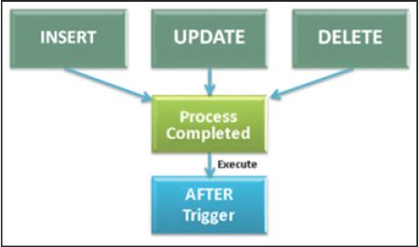
AFTER Triggers 1-3
Is executed on completion of INSERT, UPDATE, or DELETE operations and can be created only on tables.
A table can have multiple AFTER triggers defined for each INSERT, UPDATE, and DELETE operation and the user must define the order of execution of triggers.
Is executed when the constraint check in the table is completed and also the trigger is executed after the Inserted and Deleted tables are created.

Slide 23
AFTER Triggers 2-3
Syntax:
CREATE TRIGGER <trigger_name>
ON <table_name>
[WITH ENCRYPTION]
{ FOR | AFTER }
{ [ INSERT ] [ , ] [ UPDATE ] [ , ] [ DELETE ] }
AS <sql_statement>
where,
FOR | AFTER: specifies that DML trigger executes after the modification operations are complete.
{ [ INSERT ] [ , ] [ UPDATE ] [ , ] [ DELETE ] }: specifies the operations that invoke the DML trigger.

Slide 24
AFTER Triggers 3-3
Following code snippet shows how to create an AFTER DELETE trigger on the EmployeeDetails table:
CREATE TRIGGER Employee_Deletion
ON EmployeeDetails
AFTER DELETE
AS
BEGIN
DECLARE @num nchar;
SELECT @num = COUNT(*) FROM deleted
PRINT 'No. of employees deleted = ' + @num
END
Following code snippet deletes a record from the EmployeeDetails table and displays an error message:
DELETE FROM EmployeeDetails WHERE EmployeeID='E07'
Output:
No. of employees deleted = 0.

Slide 25
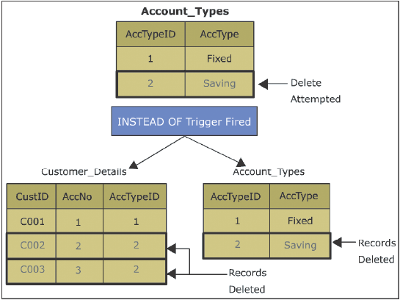
INSTEAD OF Triggers 1-3
Is executed in place of the INSERT, UPDATE, or DELETE operations.
Can be created on tables as well as views and there can be only one INSTEAD OF trigger defined for each INSERT, UPDATE, and DELETE operation.
Are executed before constraint checks are performed on the table and after the creation of the Inserted and Deleted tables.

Slide 26
INSTEAD OF Triggers 2-3
Syntax:
CREATE TRIGGER <trigger_name>
ON { <table_name> | <view_name> }
{ FOR | AFTER | INSTEAD OF }
{ [ INSERT ] [ , ] [ UPDATE ] [ , ] [ DELETE ] }
AS <sql_statement>
where,
view_name: specifies the view on which the DML trigger is created.
INSTEAD OF: specifies that the DML trigger executes in place of the modification operations. These triggers are not defined on updatable views using WITH CHECK OPTION.

Slide 27
INSTEAD OF Triggers 3-3
Following code snippet creates an INSTEAD OF DELETE trigger on the Account_Transactions table:
CREATE TRIGGER Delete_AccType
ON Account_Transactions
INSTEAD OF DELETE
AS
BEGIN
DELETE FROM EmployeeDetails WHERE EmployeeID IN
(SELECT TransactionTypeID FROM deleted)
DELETE FROM Account_Transactions WHERE TransactionTypeID IN
(SELECT TransactionTypeID FROM deleted)
END

Slide 28
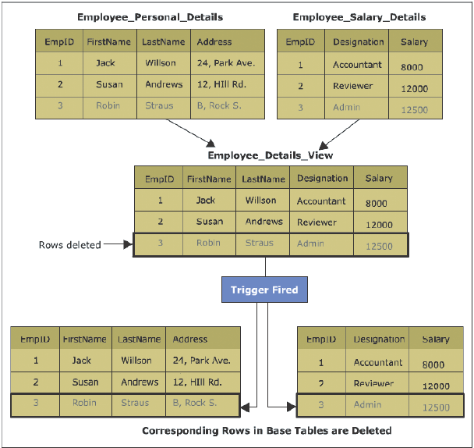
Using INSTEAD OF Triggers with Views 1-3
Can be specified on tables as well as views and provides a wider range and types of updates that the user can perform against a view.
Each table or view is limited to only one INSTEAD OF trigger for each triggering action (INSERT, UPDATE, or DELETE) and cannot be used with views having WITH CHECK OPTION clause.

Slide 29
Using INSTEAD OF Triggers with Views 2-3
Following code snippet creates a table named Employee_Personal_Details:
CREATE TABLE Employee_Personal_Details
(
EmpID int NOT NULL,
FirstName varchar(30) NOT NULL,
LastName varchar(30) NOT NULL,
Address varchar(30)
)
Following code snippet creates a table named Employee_Salary_Details:
CREATE TABLE Employee_Salary_Details
(
EmpID int NOT NULL,
Designation varchar(30),
Salary int NOT NULL
)

Slide 30
Using INSTEAD OF Triggers with Views 3-3
Following code snippet creates a view from table named Employee_Personal_Details and Employee_Salary_Details:
CREATE VIEW Employee_Details_View
AS
SELECT e1.EmpID, FirstName, LastName, Designation, Salary
FROM Employee_Personal_Details e1
JOIN Employee_Salary_Details e2
ON e1.EmpID = e2.EmpID
Following code snippet creates an INSTEAD OF DELETE trigger Delete_Employees on the view:
CREATE TRIGGER Delete_Employees
ON Employee_Details_View
INSTEAD OF DELETE
AS
BEGIN
DELETE FROM Employee_Salary_Details WHERE EmpID IN
(SELECT EmpID FROM deleted)
DELETE FROM Employee_Personal_Details WHERE EmpID IN
(SELECT EmpID FROM deleted)
Following code snippet deletes a row from the view:
DELETE FROM Employee_Details _View WHERE EmpID='3'

Slide 31
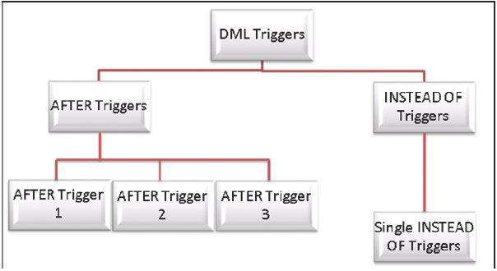
Working with DML Triggers 1-3
When users have multiple AFTER triggers on a triggering action, all of these triggers must have a different name.
An AFTER trigger can include a number of SQL statements that perform different functions.

Slide 32
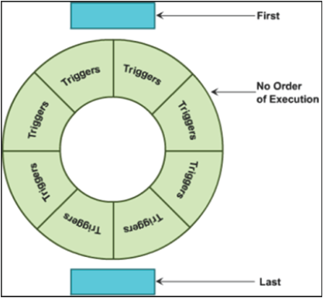
Working with DML Triggers 2-3
Execution Order of DML Triggers
SQL Server 2012 allows users to specify which AFTER trigger is to be executed first and which is to be executed last.
All the triggering actions have a first and last trigger defined for them. However, no two triggering actions on a table can have the same first and last triggers.

Slide 33
Working with DML Triggers 3-3
Syntax:
sp_settriggerorder [ @triggername = ] '[ triggerschema. ] triggername'
, [ @order = ] 'value'
, [ @stmttype = ] 'statement_type'
where,
[ triggerschema.] triggername: is the name of the DML or DDL trigger and the schema to which it belongs and whose order needs to be specified.
value: specifies the execution order of the trigger as FIRST, LAST, or NONE. If FIRST is specified, then the trigger is fired first.
statement_type: specifies the type of SQL statement (INSERT, UPDATE, or DELETE) that invokes the DML trigger.
Following code snippet executes the Employee_Deletion trigger defined on the table when the DELETE operation is performed:
EXEC sp_settriggerorder @triggername = 'Employee_Deletion ', @order = 'FIRST', @stmttype = 'DELETE

Slide 34
Viewing Definitions of DML Triggers
A trigger definition includes the trigger name, the table on which the trigger is created, the triggering actions, and the SQL statements that are executed.
SQL Server 2012 provides sp_helptext stored procedure to retrieve the trigger definitions.
DML trigger name must be specified as the parameter when executing sp_helptext.
Syntax:
sp_helptext '<DML_trigger_name>'
where,
DML_trigger_name: specifies the name of the DML trigger whose definitions are to be displayed.
Following code snippet creates a table named Employee_Salary_Details:
sp_helptext 'Employee_Deletion'

Slide 35
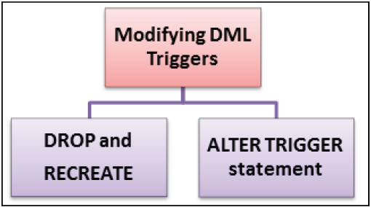
Modifying Definitions of DML Triggers 1-3
Trigger parameters are defined at the time of creating a trigger and include the type of triggering action that invokes the trigger and the SQL statements that are executed.
User can modify any of these parameters for a DML trigger in any one of two ways:
Drop and re-create the trigger with the new parameters.
Change the parameters using the ALTER TRIGGER statement.
A DML trigger can be encrypted to hide its definition.

Slide 36
Modifying Definitions of DML Triggers 2-3
Syntax:
ALTER TRIGGER <trigger_name>
ON { <table_name> | <view_name> }
[WITH ENCRYPTION]
{ FOR | AFTER | INSTEAD OF }
{ [ INSERT ] [ , ] [ UPDATE ] [ , ] [ DELETE ] }
AS <sql_statement>
where,
WITH ENCRYPTION: specifies that the DML trigger definitions are not displayed.
FOR | AFTER: specifies that the DML trigger executes after the modification operations are complete.
INSTEAD OF: specifies that the DML trigger executes in place of the modification operations.

Slide 37
Modifying Definitions of DML Triggers 3-3
Following code snippet alters the CheckEmployeeID trigger created on the EmployeeDetails table using the WITH ENCRYPTION option:
ALTER TRIGGER CheckEmployeeID
ON EmployeeDetails
WITH ENCRYPTION
FOR INSERT
AS
IF 'E01' IN (SELECT EmployeeID FROM inserted)
BEGIN
PRINT 'User cannot insert the customers of Austria'
ROLLBACK TRANSACTION
END
Output:
The text for object CheckEmployeeID is encrypted.

Slide 38
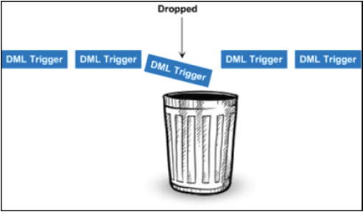
Dropping DML Triggers 1-2
Trigger can be dropped using the DROP TRIGGER statement.
Multiple triggers can also be dropped using a single drop trigger statement.
When a table is dropped, all the triggers defined on that table are also dropped.
When the DML trigger is deleted from the table, the information about the trigger is also removed from the catalog views.

Slide 39
Dropping DML Triggers 2-2
Syntax:
DROP TRIGGER <DML_trigger_name> [ ,...n ]
where,
DML_trigger_name: specifies the name of the DML trigger to be dropped.
[ ,...n ]: specifies that multiple DML triggers can be dropped.
Following code snippet drops the CheckEmployeeID trigger created on the EmployeeDetails table:
DROP TRIGGER CheckEmployeeID

Slide 40
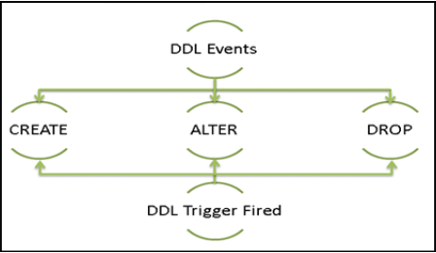
DDL Triggers 1-2
Data Definition Language (DDL) triggers execute stored procedures when DDL events such as CREATE, ALTER, and DROP statements occur in the database or the server.
DDL triggers can operate only on completion of the DDL events.
DDL triggers can be used to prevent modifications in the database schema. A schema is a collection of objects such as tables, views, and so forth in a database.
DDL triggers can invoke an event or display a message based on the modifications attempted on the schema and are defined either at the database level or at the server level.

Slide 41
DDL Triggers 2-2
Syntax:
CREATE TRIGGER <trigger_name>
ON { ALL SERVER | DATABASE }
[WITH ENCRYPTION]
{ FOR | AFTER } { <event_type> }
AS <sql_statement>
where,
ALL SERVER: specifies that the DDL trigger executes when DDL events occur in the current server.
DATABASE: specifies that the DDL trigger executes when DDL events occur in the current database.
event_type: specifies the name of the DDL event that invokes the DDL trigger.
Following code snippet creates a DDL trigger for dropping and altering a table:
CREATE TRIGGER Secure
ON DATABASE
FOR DROP_TABLE, ALTER_TABLE
AS
PRINT 'You must disable Trigger "Secure" to drop or alter tables!'
ROLLBACK

Slide 42
Scope of DDL Triggers 1-2
DDL triggers are invoked by SQL statements executed either in the current database or on the current server.
A DDL trigger created for a CREATE LOGIN statement executes on the CREATE LOGIN event in the server.
Scope of the DDL trigger depends on whether the trigger executes for database events or server events.

Slide 43
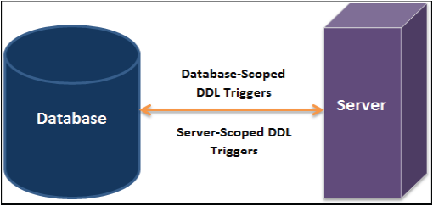
Scope of DDL Triggers 2-2
DDL triggers are classified into two types, which are as follows:
Database-Scoped DDL Triggers:
are invoked by the events that modify the database schema.
stores the triggers in the database and execute on DDL events, except those related to temporary tables.
Server-Scoped DDL Triggers:
are invoked by DDL events at the server level.
are stored in the master database.

Slide 44
Nested Triggers 1-2
Both DDL and DML triggers are nested when a trigger implements an action that initiates another trigger.
DDL and DML triggers can be nested up to 32 levels.
Nested triggers can be used to perform the functions such as storing the backup of the rows that are affected by the previous actions.
A Transact-SQL trigger executes the managed code through referencing a CLR routine, aggregate, or type, that references the counts as one level against the 32-level nesting limit.
Users can disable nested triggers, by setting the nested triggers option of sp_configure to 0 or off.

Slide 45
Nested Triggers 2-2
Following code snippet creates an AFTER DELETE trigger named Employee_Deletion on the Employee_Personal_Details table:
CREATE TRIGGER Employee_Deletion
ON Employee_Personal_Details
AFTER DELETE
AS
BEGIN
PRINT 'Deletion will affect Employee_Salary_Details table'
DELETE FROM Employee_Salary_Details WHERE EmpID IN
(SELECT EmpID FROM deleted)
END

Slide 46
UPDATE 1-2
Returns a Boolean value that specifies whether an UPDATE or INSERT action was performed on a specific view or column of a table.
Can be used anywhere inside the body of a Transact-SQL UPDATE or INSERT trigger to test whether the trigger should execute some actions.
.
Syntax:
UPDATE ( column )
where,
column: is the name of the column to test for either an INSERT or UPDATE action.

Slide 47
UPDATE 2-2
Following code snippet creates a trigger Accounting on the Account_Transactions table to update the columns TransactionID or EmployeeID:
CREATE TRIGGER Accounting
ON Account_Transactions
AFTER UPDATE
AS
IF ( UPDATE (TransactionID) OR UPDATE (EmployeeID) )
BEGIN
RAISERROR (50009, 16, 10)
END;
GO

Slide 48
Handling of Multiple Rows in a Session
When a user writes the code for a DML trigger, then the statement that causes the trigger to fire will be single statement.
Single statement will affect multiple rows of data, instead of a single row.
When the functionality of a DML trigger involves automatically recalculating summary values of one table and storing the result in another table, then multirow considerations are important.
Following code snippet stores a running total for a single-row insert:
USE AdventureWorks2012;
GO
CREATE TRIGGER PODetails
ON Purchasing.PurchaseOrderDetail
AFTER INSERT AS
UPDATE PurchaseOrderHeader
SET SubTotal = SubTotal + LineTotal
FROM inserted
WHERE PurchaseOrderHeader.PurchaseOrderID = inserted.PurchaseOrderID;

Slide 49
Performance Implication of Triggers
Triggers do not carry overheads, rather they are quite responsive.
Many performance issues can occur because of the logic present inside the trigger.
A good rule will be to keep the logic simple within the triggers and avoid using cursors while executing statements against another table and different tasks that cause performance slowdown.

Slide 50
Summary
A trigger is a stored procedure that is executed when an attempt is made to modify data in a table that is protected by the trigger.
Logon triggers execute stored procedures when a session is established with a LOGON event.
DML triggers are executed when DML events occur in tables or views.
The INSERT trigger is executed when a new record is inserted in a table.
The UPDATE trigger copies the original record in the Deleted table and the new record into the Inserted table when a record is updated.
The DELETE trigger can be created to restrict a user from deleting a particular record in a table.
The AFTER trigger is executed on completion of INSERT, UPDATE, or DELETE operations.

